Slide 1
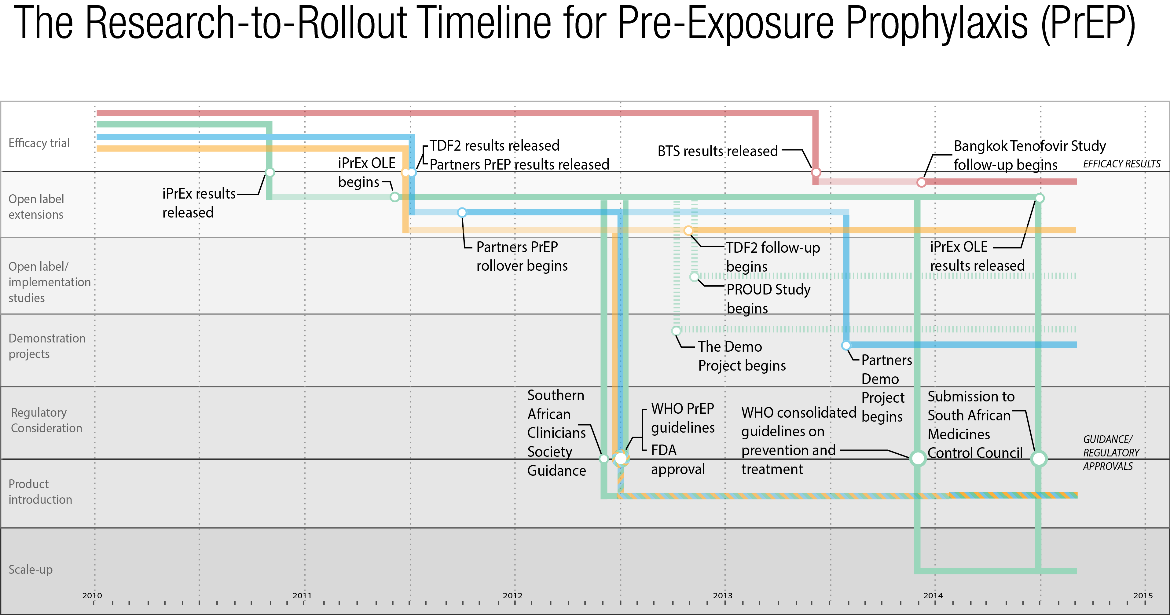
The path from PrEP research to rollout

